Slide 1
CSE 306 Computer Architecture Design of an ALU
Prepared by
Madhusudan Basak
Assistant Professor
CSE, BUET
*Some modifications made by Md. Toufikuzzaman

Slide 2
ALU and the Processor
ALU stands for Arithmetic Logic Unit
A part of the processor or CPU

Slide 3












Some Terminologies Revisiting
Decoder, Encoder
2X4
Decoder
$$Y_{0}$$
$$X_{0}$$
4X2
Encoder
$$X_{0}$$
$$Y_{1}$$
$$X_{1}$$
$$Y_{0}$$
$$X_{1}$$
$$Y_{2}$$
$$X_{2}$$
$$Y_{1}$$
$$Y_{3}$$
$$X_{3}$$
E
E

Slide 4






Some Terminologies Revisiting
DeMUX, MUX
1X4
DeMUX
$$Y_{0}$$
$$X_{0}$$
4X1
MUX
$$Y_{1}$$
$$X_{1}$$
$$X_{0}$$
$$Y_{0}$$
$$Y_{2}$$
$$X_{2}$$
$$Y_{3}$$
$$X_{3}$$
$$S_{1}$$
$$S_{0}$$
$$S_{1}$$
$$S_{0}$$

Slide 5
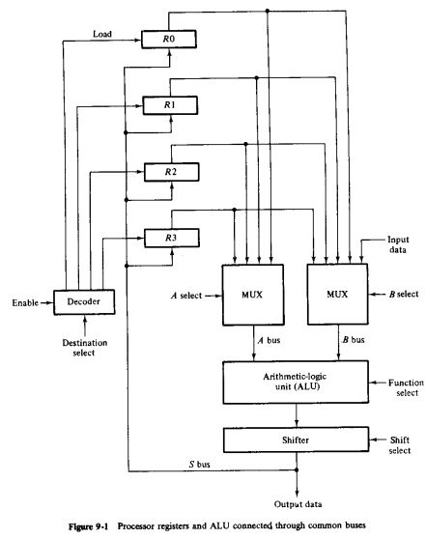
A Simplified Processor in Operation
$$R_{1}←R_{2}+R_{3}$$
0000 0001 0010 0011

Slide 6
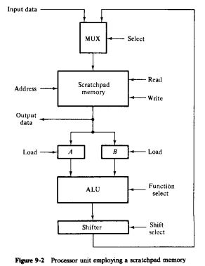

Simplified Processor with Scratchpad Memory
$$R_{1}←R_{2}+R_{3}$$

Slide 7
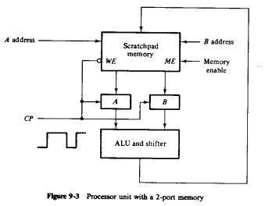
Simplified Processor with Scratchpad Memory
$$R_{1}←R_{2}+R_{3}$$

Slide 8
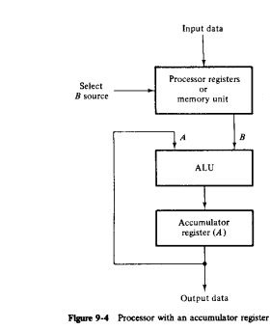

Simplified Processor with Accumulator
$$R_{1}←R_{2}+R_{3}$$

Slide 9
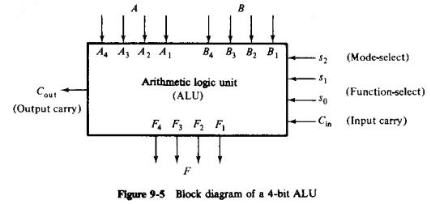
An ALU Unit
Can perform both Arithmetic and Logic Operations
Arithmetic/Logical Operation
Which Operation/Function
Helps Function-select to add more variants

Slide 10
Parallel Adder
Parallel adder
A number of full-adder circuits connected in cascade

Slide 11
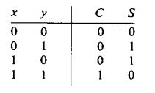
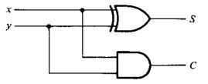

1-bit Half Adder
$S=xy^{′}+x^{′}y=x⨁y$
$C=xy$

Slide 12
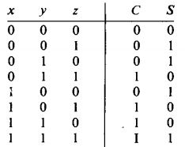
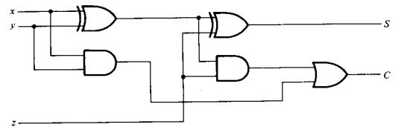



1-bit Full Adder
$S=x{′y}^{′}z+x^{′}yz^{′}+xy^{′}z^{′}+xyz$
$C=xy+xz+yz$
$$C_{out}$$
$$C_{in}$$

Slide 13
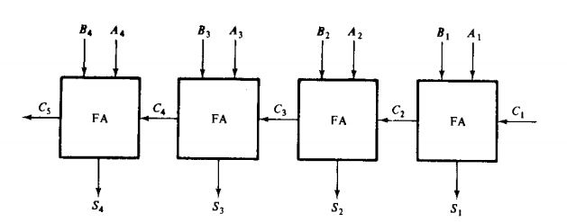
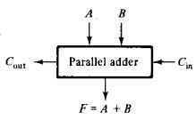

Parallel Adders
$n$ number of 1-bit full-adders are connected in cascade to form a $n$-bit parallel adder

Slide 14
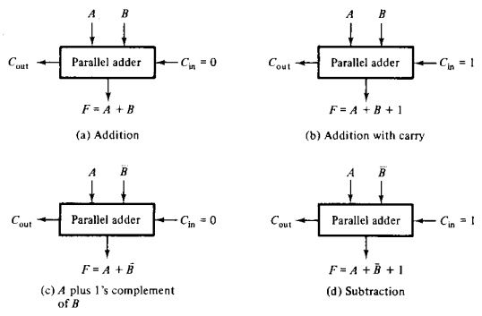
Arithmetic Operations by ALU

Slide 15
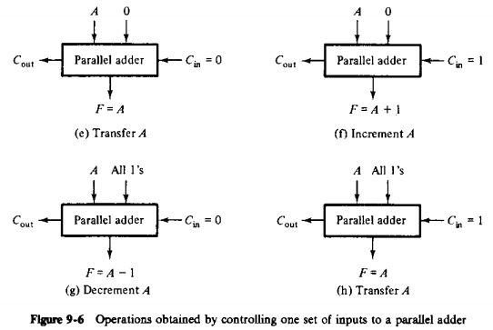
Arithmetic Operations by ALU

Slide 16
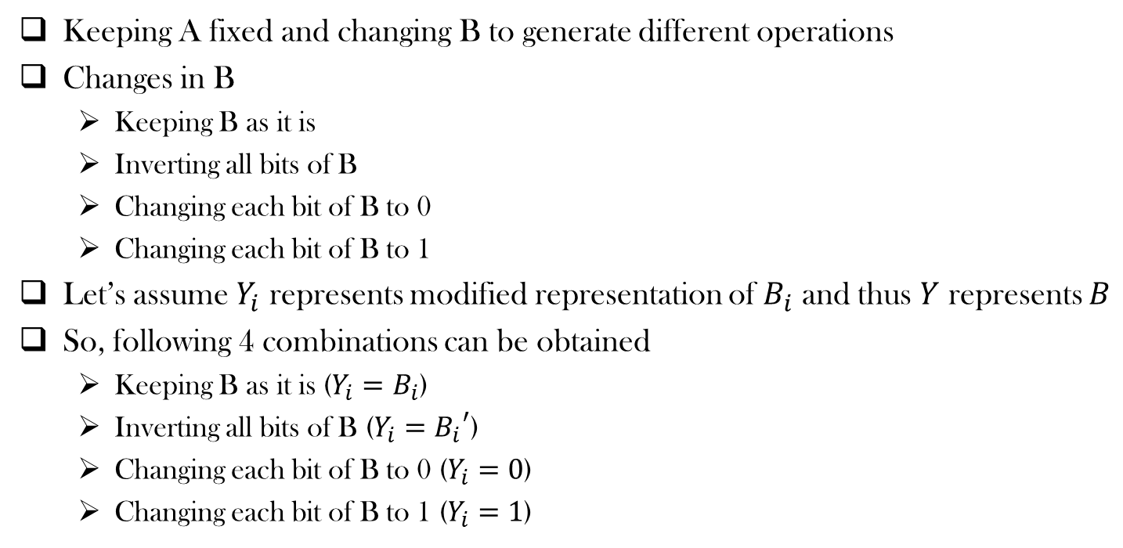
What are we doing?
Keeping A fixed and changing B to generate different operations
Changes in B
Keeping B as it is
Inverting all bits of B
Changing each bit of B to 0
Changing each bit of B to 1
Let’s assume $Y_{i}$ represents modified representation of $B_{i}$ and thus $Y$ represents $B$
So, following 4 combinations can be obtained
Keeping B as it is ($Y_{i}=B_{i}$)
Inverting all bits of B ($Y_{i}={B_{i}}^{′}$)
Changing each bit of B to 0 ($Y_{i}=0$)
Changing each bit of B to 1 ($Y_{i}=1$)

Slide 17
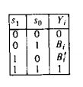
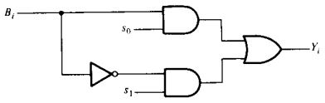

What are we doing?
So Following 4 combinations can be obtained
Keeping B as it is ($Y_{i}=B_{i}$)
Inverting all bits of B ($Y_{i}={B_{i}}^{′}$)
Changing each bit of B to 0 ($Y_{i}=0$)
Changing each bit of B to 1 ($Y_{i}=1$)
$Y_{i}=B_{i}s_{0}$ + ${B_{i}}^{′}s_{1}$

Slide 18
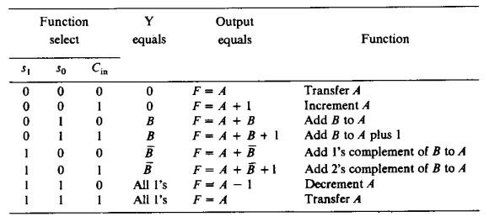

Function Table
Modified $B$

Slide 19
Function Table: Designer’s perspective
Modified $B$

Slide 20
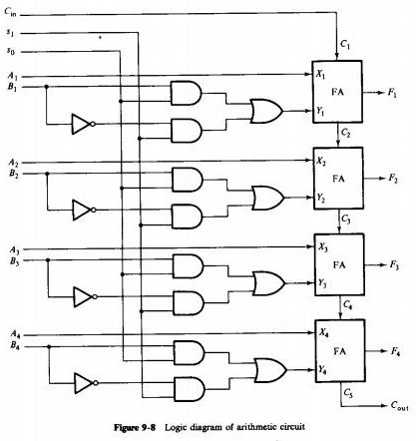






Logic Diagram of an independent Arithmetic Circuit
Selection Variables
…
Combinational Circuit
$$C_{in}$$
$n−bit$ Parallel adder
$$A$$
$$X$$
$$B$$
$$Y$$

Slide 21



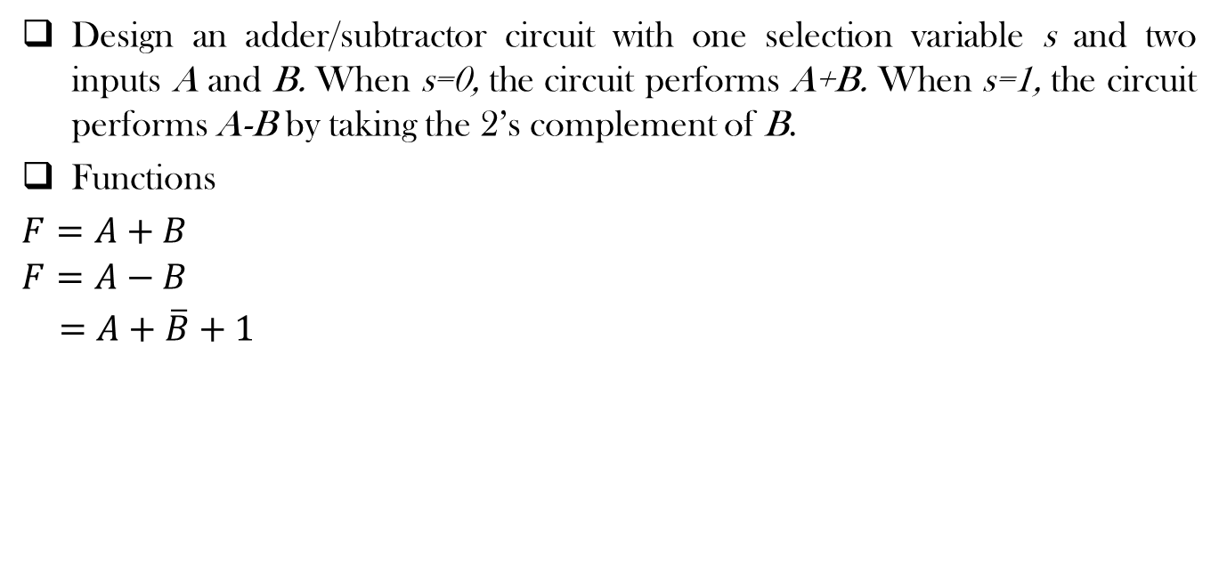

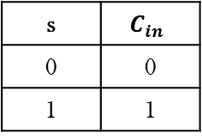



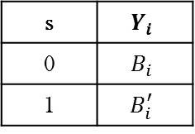
Design Example
Design an adder/subtractor circuit with one selection variable s and two inputs A and B. When s=0, the circuit performs A+B. When s=1, the circuit performs A-B by taking the 2’s complement of B.
Functions
$F=A+B$
$$F=A−B$$
$=A+\overline{B}+1$
Selection Variables
…
Combinational Circuit
$$C_{in}$$
$n−bit$ Parallel adder
$$A$$
$$X$$
s | $$Y_{i}$$
0 | $$B_{i}$$
1 | $$B_{i}^{′}$$
s | $$C_{in}$$
0 | 0
1 | 1
$$B$$
$$Y$$
$$Y_{i}=s^{′}B_{i}+sB_{i}^{′}=s⨁B_{i}$$
$$C_{in}=s$$

Slide 22
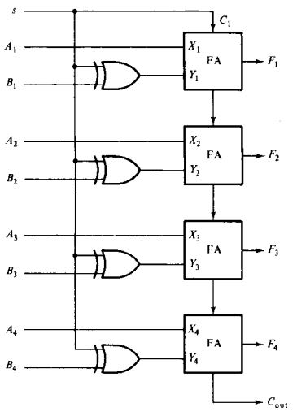
Design Example

Slide 23
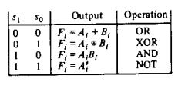
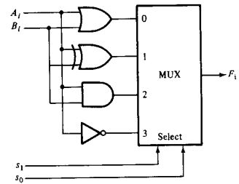
Designing a Logic Circuit
We shall implement three basic logical operations (AND, OR and NOT) and an XOR operation

Slide 24
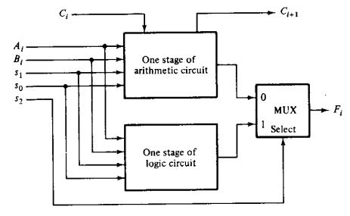
Designing a Logic Circuit
Let’s combine it with arithmetic operations

Slide 25
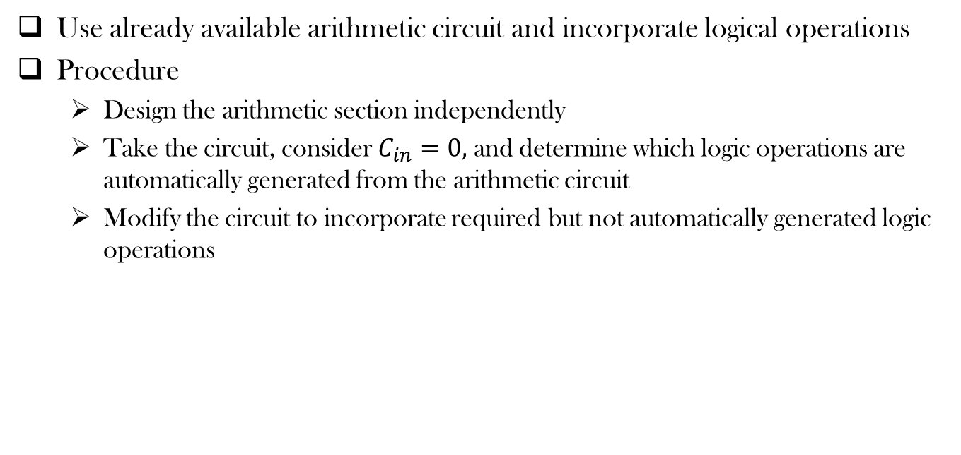
More Efficient Design
Use already available arithmetic circuit and incorporate logical operations
Procedure
Design the arithmetic section independently
Take the circuit, consider $C_{in}=0,$and determine which logic operations are automatically generated from the arithmetic circuit
Modify the circuit to incorporate required but not automatically generated logic operations

Slide 26
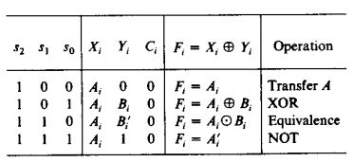
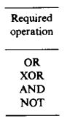
More Efficient Design
Use already available arithmetic circuit and incorporate logical operations

Slide 27
Incorporating remaining functions
Unresolved cases
$$s_{2}$$ | $$s_{1}$$ | $$s_{0}$$ | $$X_{i}$$ | $$Y_{i}$$ | Automatically Obtained $F_{i}$ | Required $F_{i}$
1 | 0 | 0 | $$A_{i}$$ | 0 | $$F_{i}=A_{i}$$ | $$F_{i}=A_{i}+B_{i}$$
1 | 1 | 0 | $$A_{i}$$ | $$B_{i}^{′}$$ | $$F_{i}=A_{i} ⨀{ B}_{i}$$ | $$F_{i}=A_{i}B_{i}$$

Slide 28
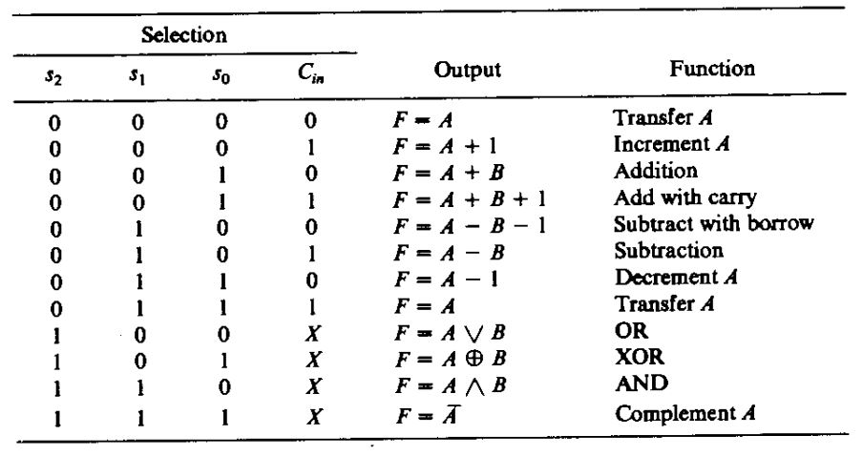

Final Boolean Functions
Combining the arithmetic and logical cases, we get the final form of the Boolean function as:
$$X_{i}=A_{i}+s_{2}s_{1}^{′}s_{0}^{′}B_{i}+s_{2}s_{1}s_{0}^{′}B_{i}^{′}$$
$$Y_{i}=s_{0}B_{i}+s_{1}B_{i}^{′}$$
$$Z_{i}=s_{2}^{′}C_{i}$$

Slide 29
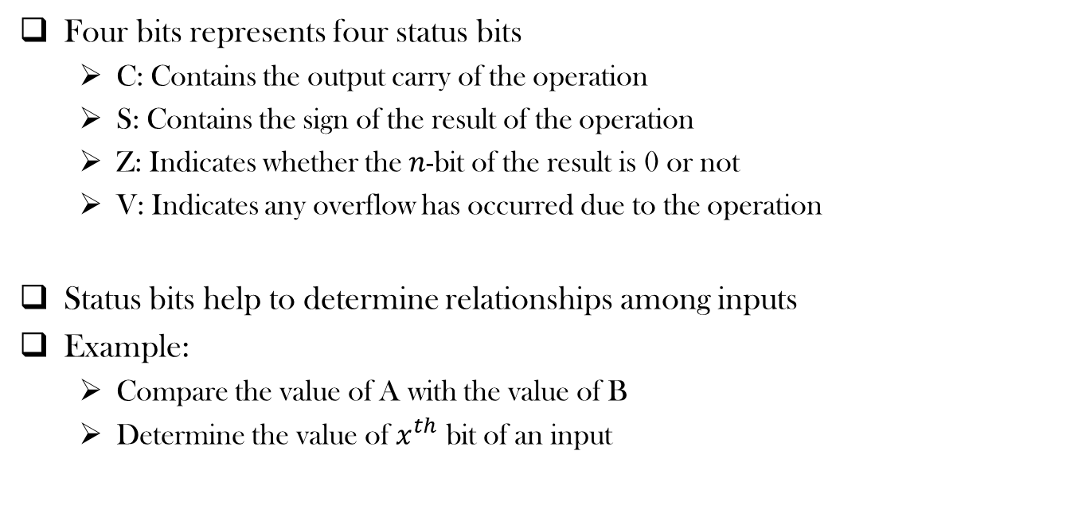
Status Register
Four bits represents four status bits
C: Contains the output carry of the operation
S: Contains the sign of the result of the operation
Z: Indicates whether the $n$-bit of the result is 0 or not
V: Indicates any overflow has occurred due to the operation
Status bits help to determine relationships among inputs
Example:
Compare the value of A with the value of B
Determine the value of $x^{th}$ bit of an input

Slide 30
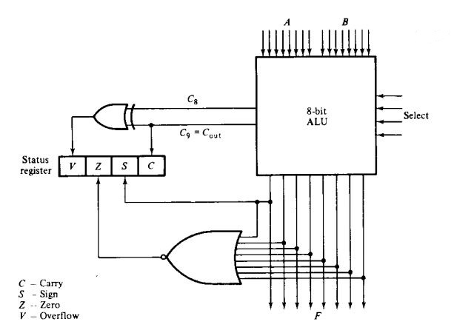
Status Register

Slide 31
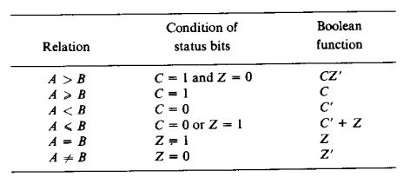

Comparing two unsigned numbers
Compare the value of A with the value of B
Check the status bits (mainly C and Z) after the performing the following operation
$$F=A−B$$
$$=2^{n}+(A−B)$$

Slide 32
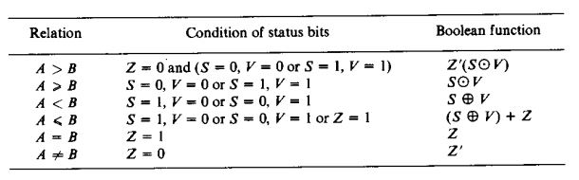

Comparing two signed numbers
Compare the value of A with the value of B
Check the status bits (mainly V and S) after the performing the following operation
$$F=A−B$$

Slide 33
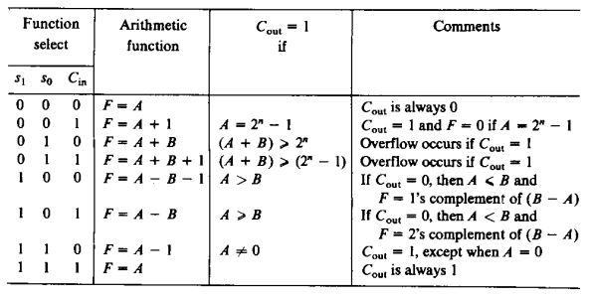
Effect of Output Carry

Slide 34
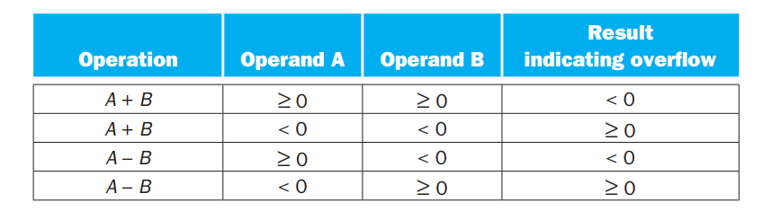
Overflow Flag

Slide 35
References
Digital Logic and Computer Design by M. Morris Mano
Chapter 9 (9.1-9.7)

Slide 36
Thank You ☺

